Slide 1
Presentation about embedded system

Slide 2


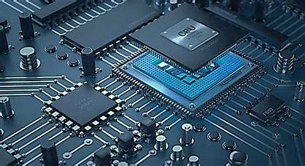


Embedded systems
A combination of software and hardware
Performs a specific task as a part of larger system

Slide 3


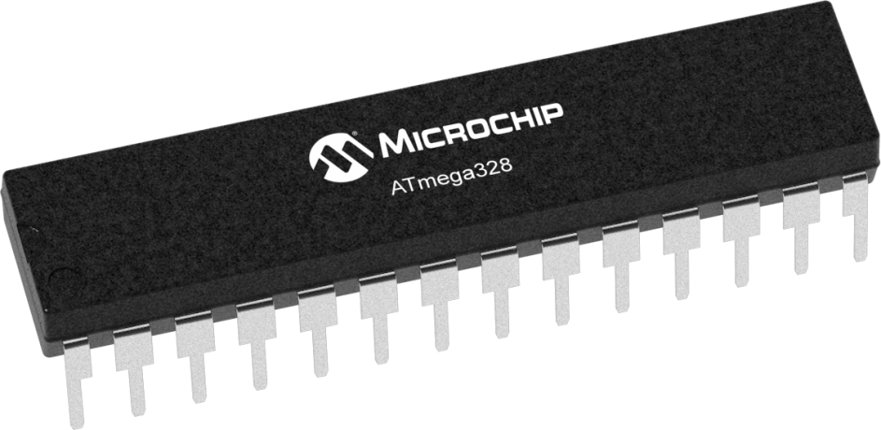



Embedded System
Embedded system is a system include software[Programing language] and hardware[Microcontroller]combination to Reach specific target.
Specific Target
Embedded System
3
15-Feb-25

Slide 4
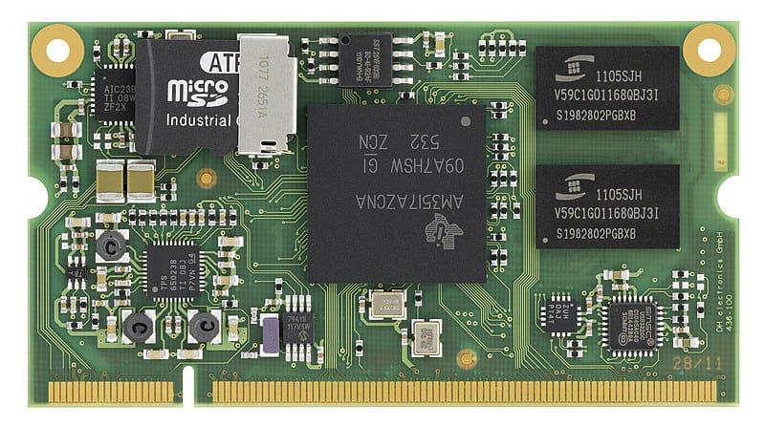
Session 1: Introduction to Embedded systems
{Goal}:provide an overview of embedded systems , introduce ARM architecture , and set up STM32CubeIDE

Slide 5

What is Embedded Systems?
An embedded system is a specialized computing system designed to perform dedicated functions or tasks within a larger system. Unlike general-purpose computers, embedded systems are optimized for efficiency, reliability, and real-time performance.
1-Difference between Embedded system and computing system
Embedded system
Specialized system designed for a specific task
Optimized for low power consumption
Ex: washing machines, ATMs , automotive ECUs
computing system
System designed for multiple tasks and user interactions
Higher power requirement
Ex : Laptops, desktops, smartphones

Slide 6
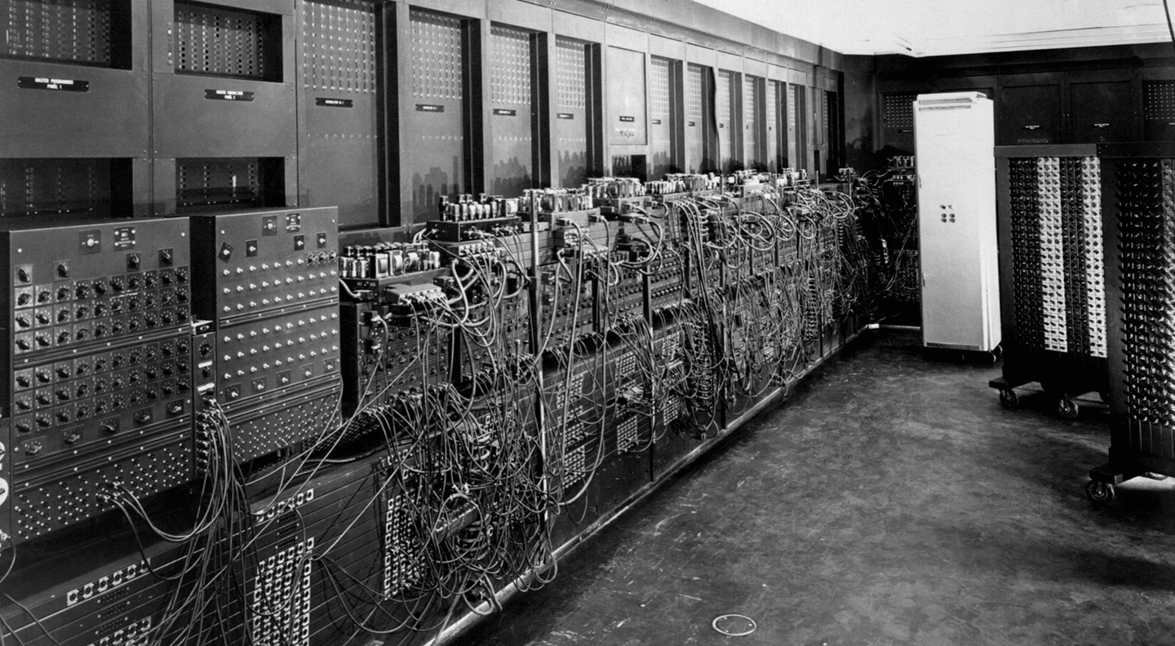

Slide 7
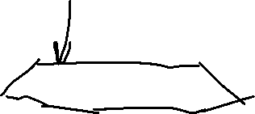




Slide 8
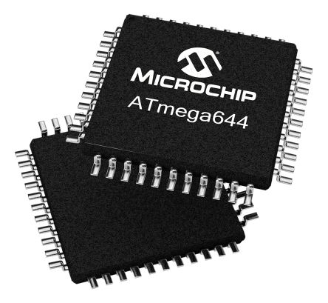
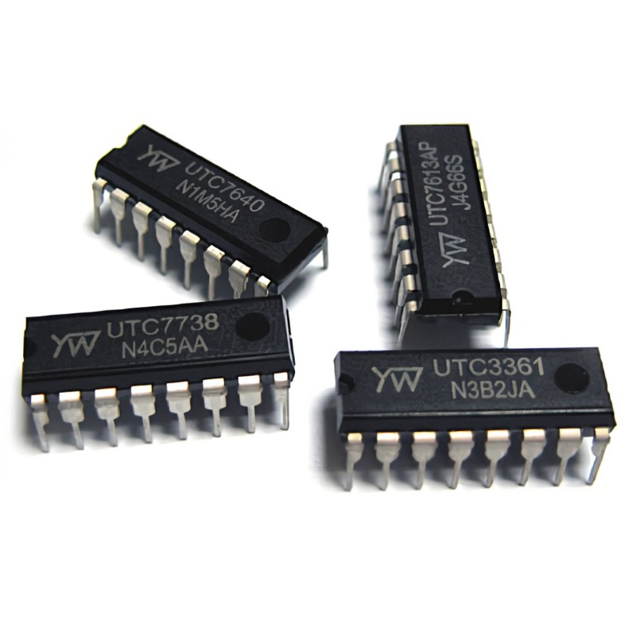
IC (Integrated circuit ) "chip"
An assembly of electronic components like capacitors and resistors to perform a specific function like AND gate IC
Has different shapes but its function is known from the number printed on it and its data sheet not from its shape
8
15-Feb-25

Slide 9
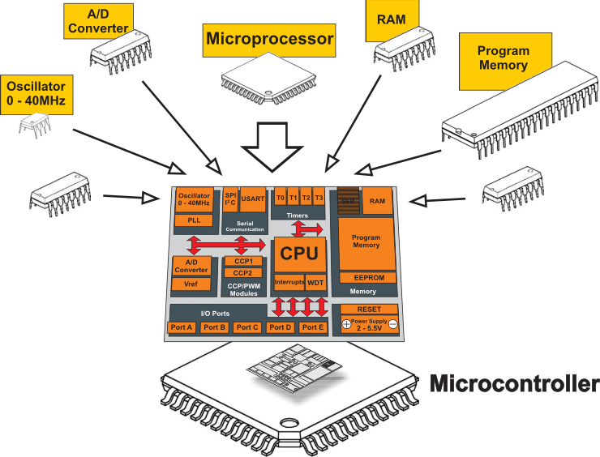
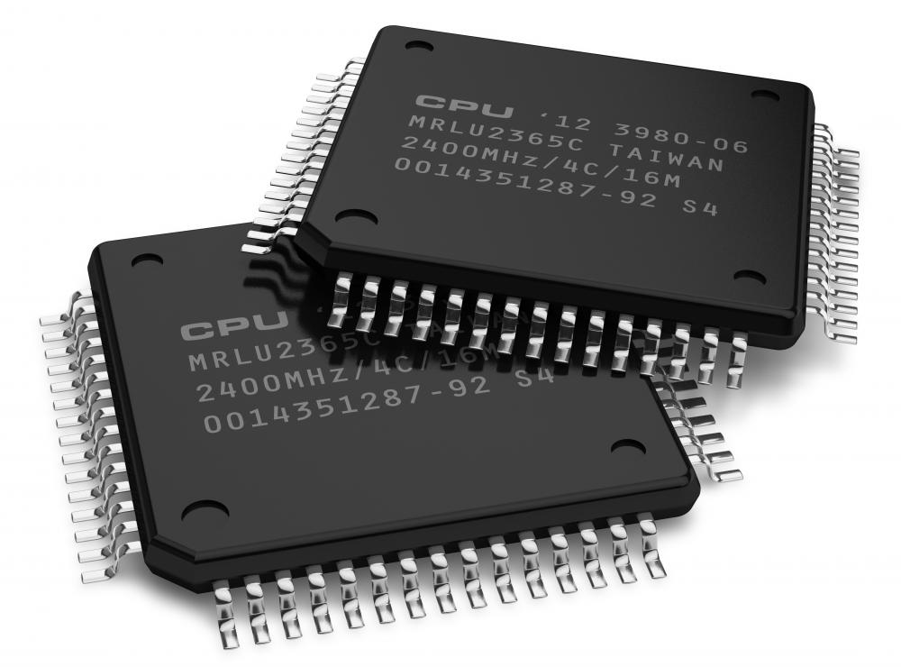
MPU Vs. MCU
Microprocessor
Microcontroller
It is the brain of the system
Consist of CPU only
It is a small computer on single integrated circuit containing
9
15-Feb-25

Slide 10
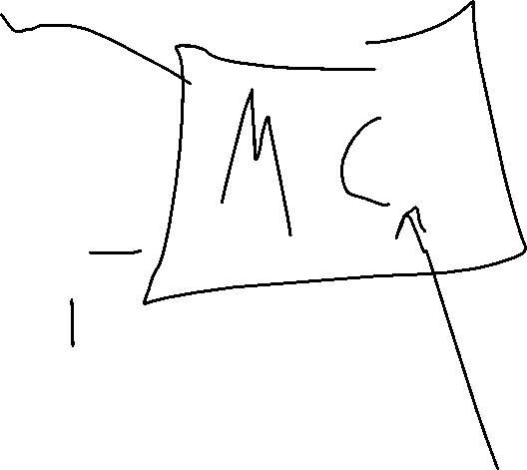

Slide 11
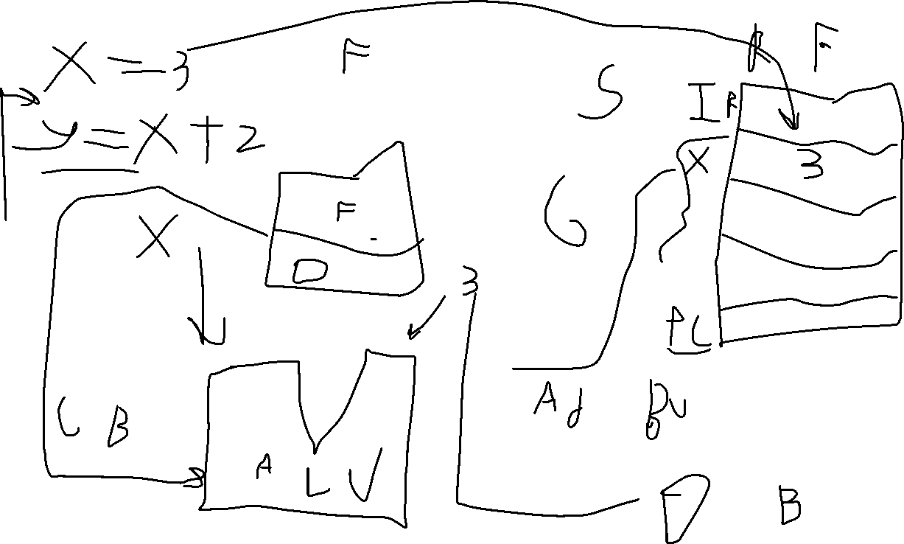

Slide 12

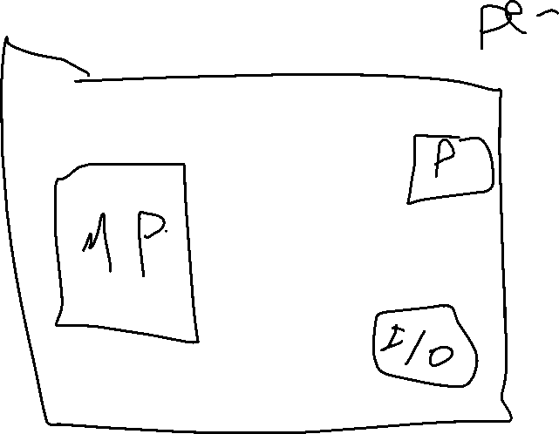


Slide 13
2-Difference Between Microcontrollers and Microprocessors
microcontrollers
A compact integrated chip that includes a processor, memory and peripherals
Used in embedded systems for specific tasks
Low power optimized for energy efficiency
microprocessors
A processing unit that requires external memory and peripherals
Used in computing systems for general-purpose tasks
High power consumption
* Examples of embedded systems in real life :(smartphones, cars, IoT)

Slide 14
Understanding the General Microprocessor Architecture
1-Introduction to Microcontroller Architecture
A microcontroller is a compact integrated circuit designed to govern a specific operation in an embedded system. It includes a processor, memory, and input/output (I/O) peripherals on a single chip, making it a cost-effective and efficient solution for control applications.
2-How a Microcontroller Runs Code
1-Code Writing & Compilation
2-Code Upload to Flash Memory
3-Power-On & Reset Process
4-Fetch-Decode-Execute Cycle
5-Interrupt Handling (If Required)
6-Continuous Execution

Slide 15
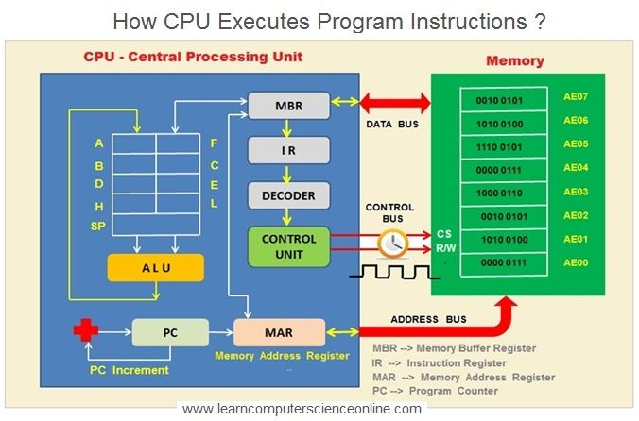
Simple Microprocessor

Slide 16
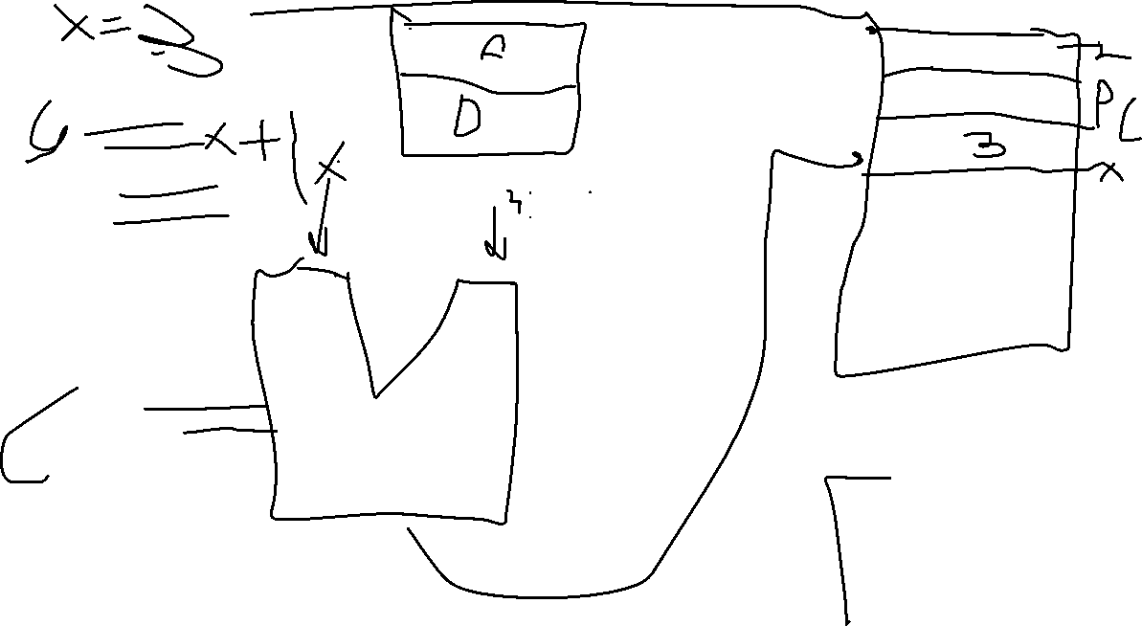

Slide 17
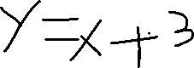



3-Instruction set : RISCvsCISC
RISC
Simple fixed-length instructions
Larger programs (more instructions needed)
More general-purpose registers
CISC
Complex variable-length instructions
Smaller programs (fewer instructions needed)
Fewer general-purpose registers
4-processor Architecture:Von neumann vs Harvard
Von neumann
Unified memory for program and data
Slower due to bus contention
Simpler hardware
Harvard
Separate memory for program and data
Faster due to simultaneous access
More complex hardware

Slide 18
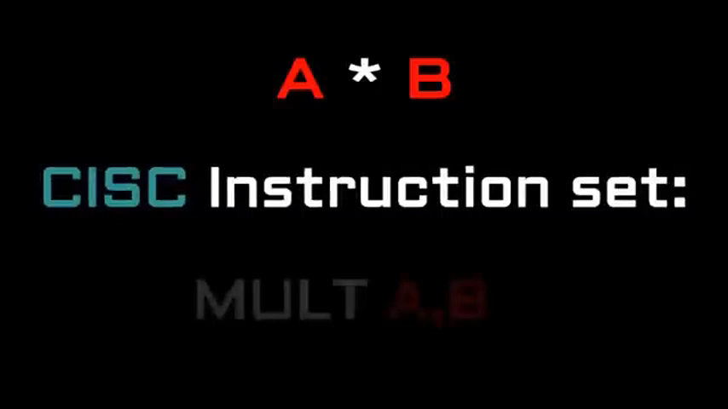

CISC VS RISC

Slide 19
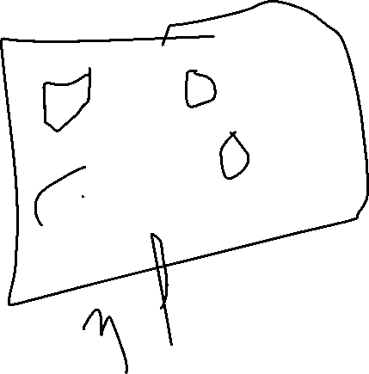




Slide 20
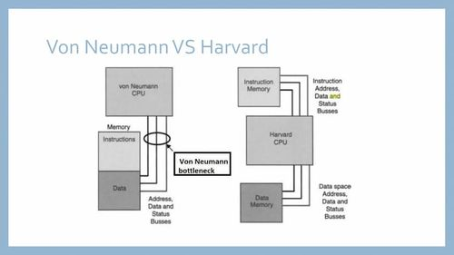
Von Neuman Vs Harvard

Slide 21
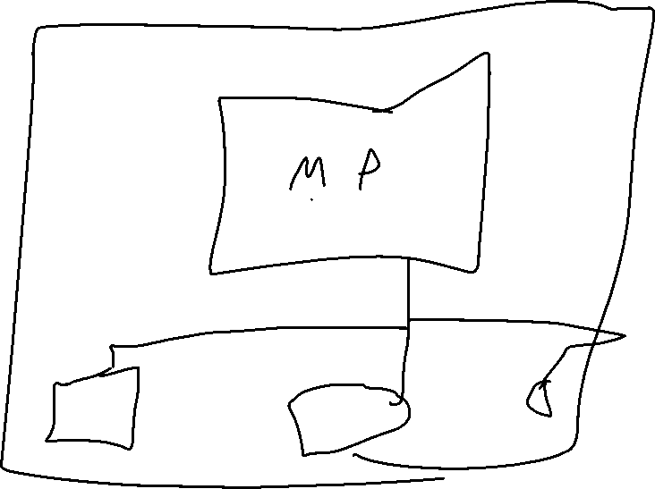

Slide 22
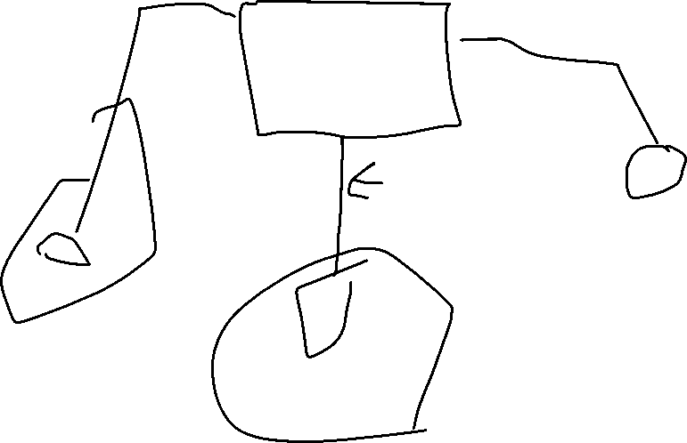

Slide 23
5-Memory organization in microcontrollers (RAM Vs ROM)
RAM
Temporary storage for variables,stack and data
Volatile(data lost when power is off)
Stores runtime variables,stack and temporary data
ROM
Permanent storage for program code (firmware)
Non-volatile(data remained after power-off)
Stores firmware , bootloader and constants
6-RAM :SPAM vs DRAM
SPAM(static RAM)
Speed:faster
Coast:Expensive
Power consumption:lower
DRAM(Dynamic RAM)
Speed:slower
Coast:Cheaper
Power consumption:Higher

Slide 24





Slide 25
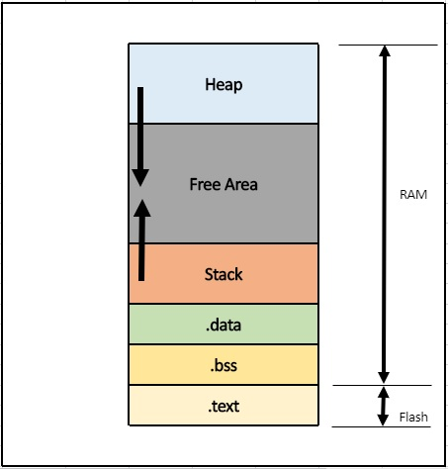





Slide 26
7-ROM (Masked ROM, OTPROM, EPROM, EEROM and Flash)
1. Masked ROM (MROM)
Description: Pre-programmed during manufacturing. Once data is written, it cannot be modified.
Advantages: Cost-effective for mass production.
Disadvantages: Cannot be updated; errors require a new chip
Use Cases: Embedded systems, gaming cartridges, microcontroller firmware
2. OTPROM (One-Time Programmable ROM)
Description: Programmable by the user only once using a special device
.Advantages: More flexible than MROM; allows programming after manufacturing.
Disadvantages: Cannot be erased or reprogrammed.
Use Cases: Security keys, firmware storage in industrial applications.

Slide 28
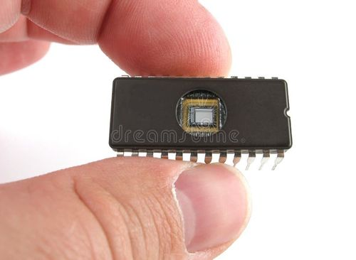

3. EPROM (Erasable Programmable Read-Only Memory)
Description: Can be erased using UV light and reprogrammed multiple times.
Advantages: Allows updates and debugging.
Disadvantages: Requires UV exposure for erasure; slower than EEPROM.
Use Cases: Older BIOS chips, microcontrollers, and legacy embedded systems.
4. EEPROM (Electrically Erasable Programmable Read-Only Memory)
Description: Can be erased and reprogrammed using electrical signals.
Advantages: Byte-level erasing and rewriting, more flexible than EPROM.
Disadvantages: Slower write speeds, limited write cycles.
Use Cases: Microcontrollers (e.g., for storing configuration data), smart cards, RFID.
5. Flash Memory
Description: An advanced form of EEPROM that erases and writes in blocks rather than bytes.
Advantages: Faster than EEPROM, high storage density, cost-effective.
Disadvantages: Limited write cycles (~10,000 to millions), block-level erasure.
Use Cases: USB drives, SSDs, microcontrollers, mobile phones

Slide 30
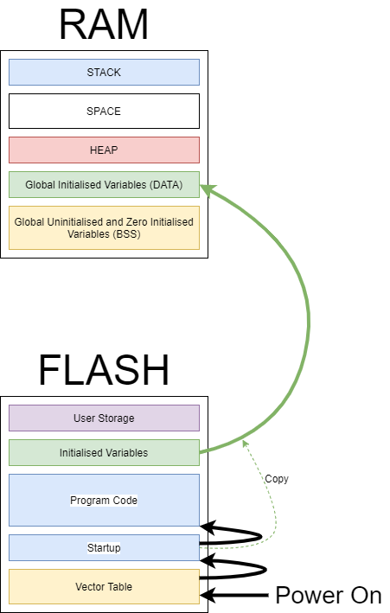


Slide 31

8-Toolchain in Embedded Systems
A toolchain is a set of software tools used to convert source code into an executable binary for a microcontroller or processor.
1-Preprocessing (Preprocessor)
Handles preprocessor directives like #include, #define, and macros
2-Compilation (Compiler)
Converts preprocessed C code into Assembly code.
3. Assembly (Assembler)
Converts Assembly code into machine code (binary instructions).
4. Linking (Linker)
Combines multiple object files and libraries into a single executable.

Slide 33

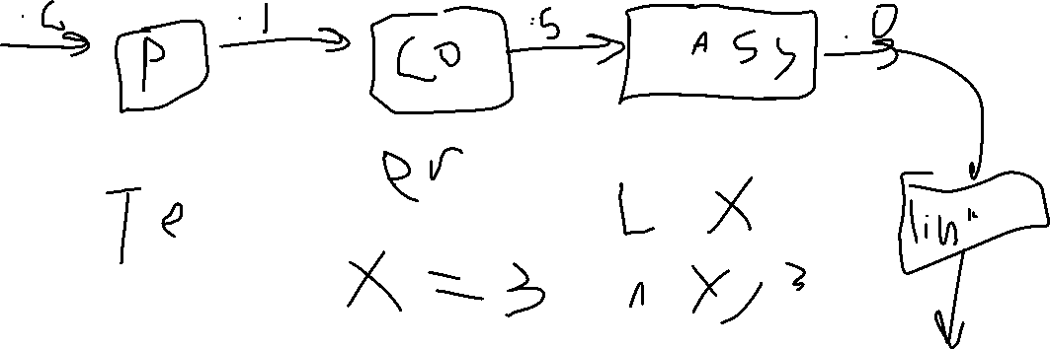

Slide 34
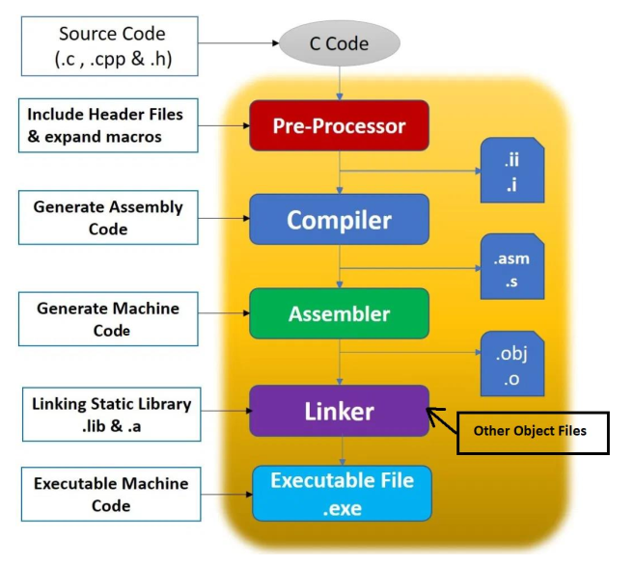










8-Toolchain in Embedded Systems

Slide 35
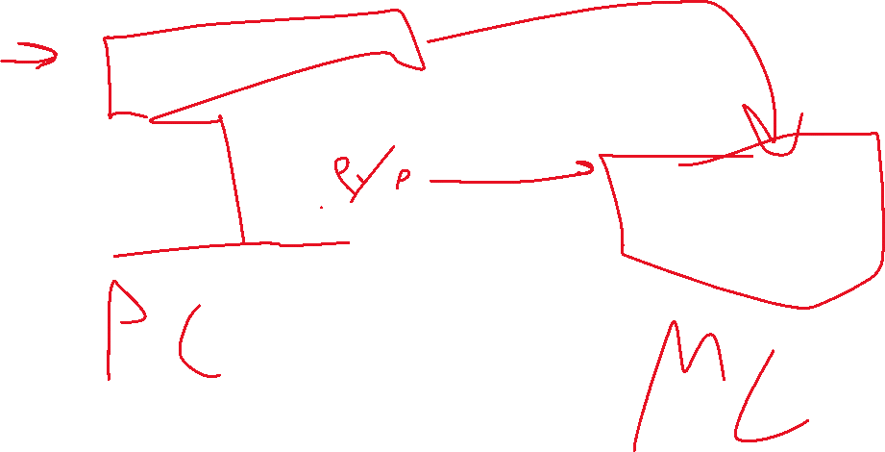

Slide 36
9-Flashing (Off circuit vs On circuit)
Flashing refers to writing firmware onto a microcontroller’s non-volatile memory (e.g., Flash, EEPROM).
1. Off-Circuit Flashing (Offline / External Programmer)
The microcontroller is removed from the circuit and placed in an external programmer
Used when the microcontroller does not support in-circuit programming or for mass production.
2. On-Circuit Flashing (In-System Programming - ISP / In-Circuit Serial Programming - ICSP)
The microcontroller is programmed while soldered to the PCB using a debug/programming interface (JTAG, SWD, UART, SPI, I²C).
Common in firmware updates, debugging, and field programming.

Slide 37



Slide 38
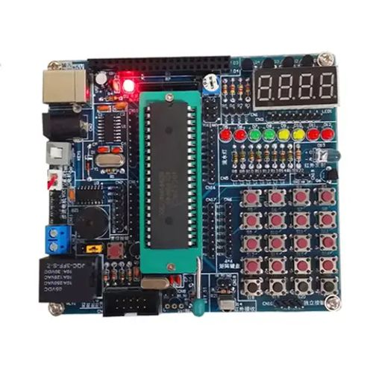
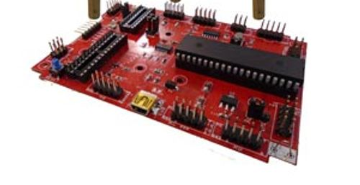








Off circuit Vs On circuit

Slide 39
10-Embedded Software Architecture ( APP, HAL LIB AND LL)
Embedded software is typically organized into layers to improve portability, modularity, and maintainability. The common architecture includes:
1. Application Layer (APP)
The highest layer containing the main application logic.
Uses drivers and libraries to interact with hardware.
2. Hardware Abstraction Layer (HAL)
Provides an abstraction between the hardware and application.
Uses high-level APIs to control hardware without direct register manipulation.
3. Low-Level (LL)
DriversDirectly interacts with hardware registers.
Provides fast and efficient access to peripherals with minimal abstraction.
4. Middleware / Libraries (LIB)
Contains protocol stacks, algorithms, and drivers that are independent of the hardware.

Slide 40
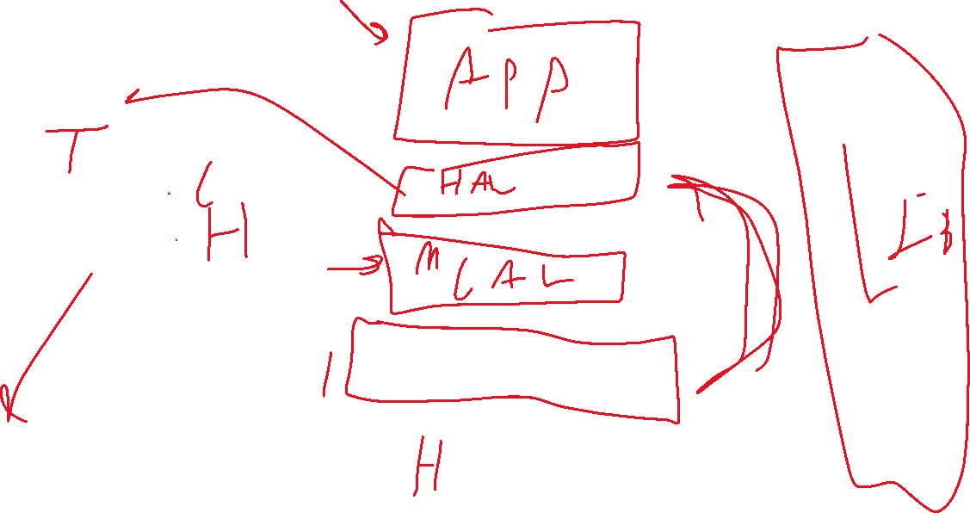

Slide 41
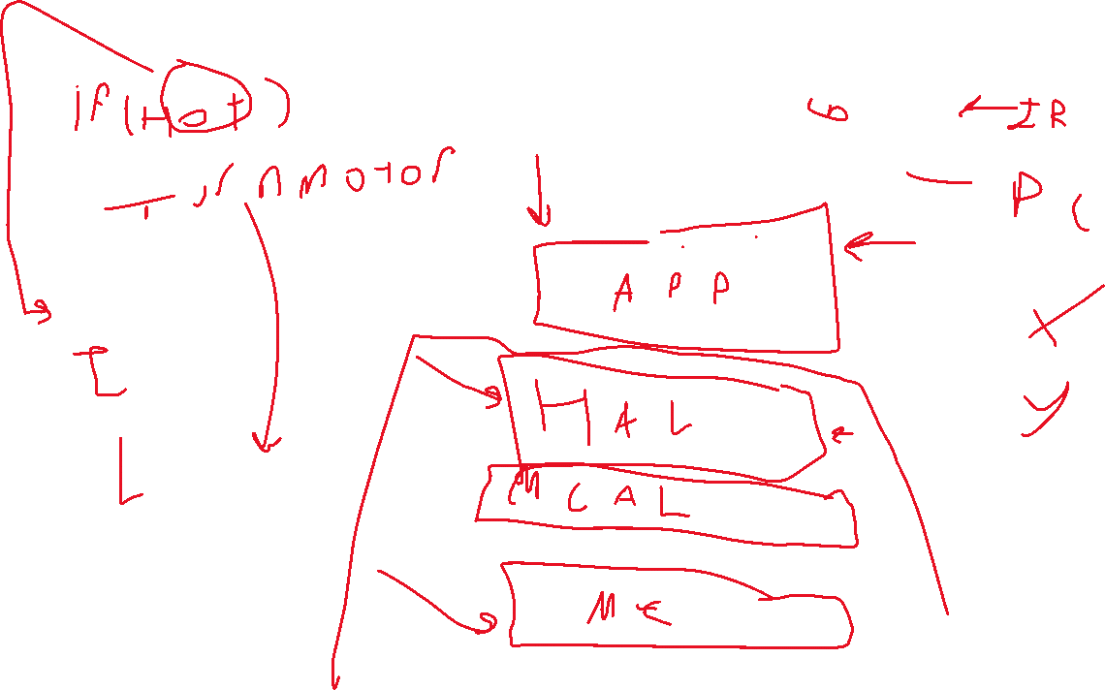

Slide 42
10-Embedded Software Architecture

Slide 43


Understanding the ARM Architecture
1-Introduction to ARM (ARM history, what ARM stands for)
ARM stands for "Advanced RISC Machine". It is a family of Reduced Instruction Set Computing (RISC) architectures widely used in embedded systems, mobile devices, and high-performance computing. ARM processors are known for their power efficiency and scalability, making them the dominant choice for smartphones, tablets, IoT devices, and even some laptops and servers.
History of ARM
1. Acorn RISC Machine (1983-1990)
ARM was originally developed by Acorn Computers in the 1980s for their desktop computers.
The first ARM processor, ARM1, was designed in 1985.
In 1987, ARM2 was introduced, featuring a simple design with only 30,000 transistors (compared to Intel’s 80386, which had around 275,000 transistors).

Slide 44
2. Formation of ARM Ltd (1990)
In 1990, Acorn Computers, Apple, and VLSI Technology formed Advanced RISC Machines Ltd.
Apple used ARM processors in their Newton PDA (1993).
3. Growth and Adoption (1990s-2000s)
ARM processors started appearing in mobile phones, PDAs, and embedded systems.
ARM7TDMI (1994) became one of the most popular microcontroller cores.
ARM introduced Thumb instruction set for better code density.
4. Smartphone Revolution (2000s-2010s)
With the rise of smartphones, ARM processors dominated the market.
Apple, Samsung, and Qualcomm started using ARM-based architectures.
ARM Cortex-A series (A8, A9, A15) powered devices like the iPhone and Android phones.
5. Modern Era (2010s-Present)
ARM processors evolved to support 64-bit computing (ARMv8-A, 2011).
Apple transitioned its entire Mac lineup to ARM-based Apple Silicon (M1, M2, M3).
ARM is now used in automotive, data centers, AI applications, and even high-performance computing.

Slide 45
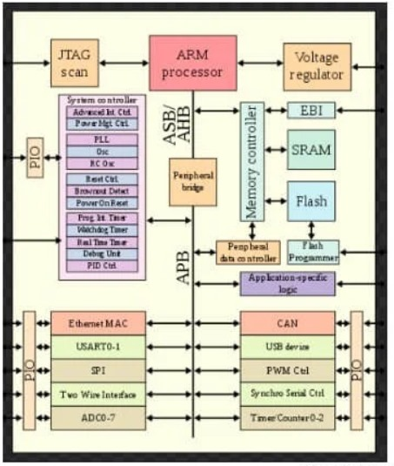







Slide 46
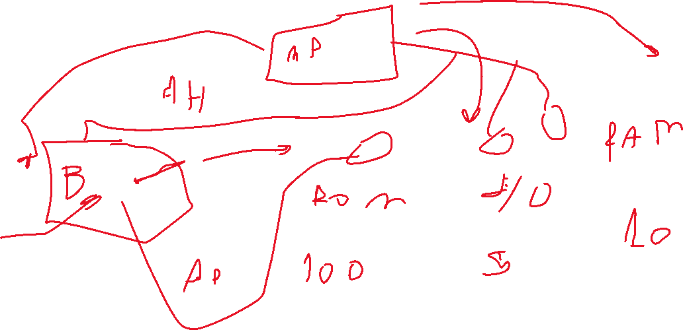

Slide 47
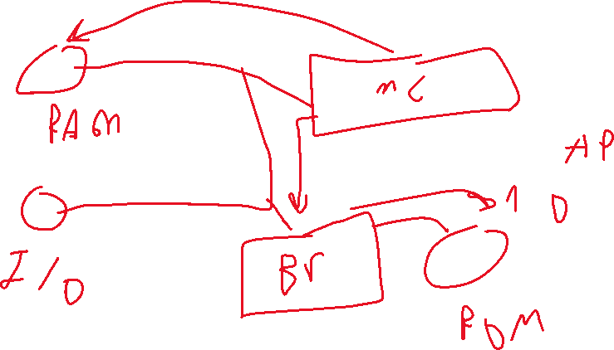

Slide 48
2-ARM Architecture (voltage regulator, PIO and communication prephrals)
1. Voltage Regulator in ARM Systems
A voltage regulator ensures a stable power supply to different parts of an ARM-based system. It converts input voltage to the required levels for core logic, peripherals, and I/O.
2. Parallel I/O (PIO) and Communication Peripherals
Parallel I/O (PIO):
Used to interface with GPIO (General-Purpose I/O) pins.
Can be configured as input/output
ARM-based microcontrollers and processors: support a variety of communication peripherals to interact with external devices such as sensors, memory modules, displays, and networks.
These peripherals operate through different protocols, categorized as either serial or parallel communication.

Slide 49
3-Intro to AMBA (AHB vs APB, Peripheral bridge)
AMBA (Advanced Microcontroller Bus Architecture) is a protocol developed by ARM to standardize the communication between different components of an ARM-based system. It is widely used in microcontrollers, SoCs (System-on-Chips), and embedded systems to manage high-speed data transfer and peripheral control.
Peripheral bridge
Since AHB and APB operate at different speeds, a peripheral bridge is used to connect AHB (fast bus) to APB (slow bus).
The bridge translates high-speed transactions into low-speed ones, ensuring efficient communication with peripherals.
AHB
Speed:High
More complex
Uses a high-speed system clock
APB
Speed:low
Simpler
Typically runs on a divided. Slower clock

Slide 50
4-Power management (RCC vs Enable)
Power management in ARM-based microcontrollers involves controlling clocks and power to various peripherals and system components.
Key Difference:
RCC: is a global controller for system clocks and resets.
Enable Registers: are specific to peripherals, allowing fine-grained power control.
Introduction to STM32CubeIDE
1-Why STM32 is widely used in the industry
*ARM Cortex Architecture
STM32 MCUs are based on the ARM Cortex-M series (M0, M3, M4, M7, etc.), providing scalability, efficient processing, and strong ecosystem support.
*Strong Community & Open-Source Support
Large developer and open-source communities provide ample resources, libraries, and third-party tools for STM32 development.

Slide 51

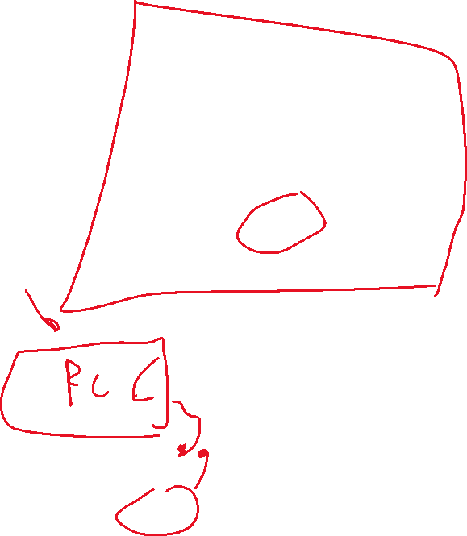

Slide 52
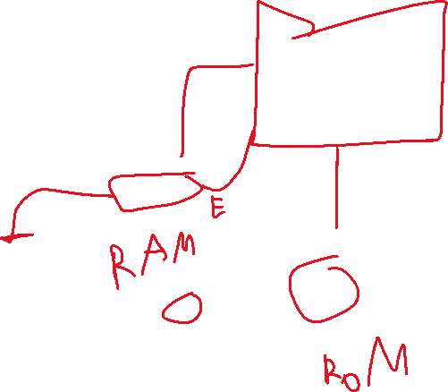
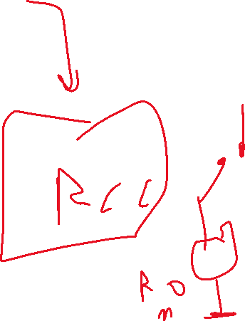

Slide 53
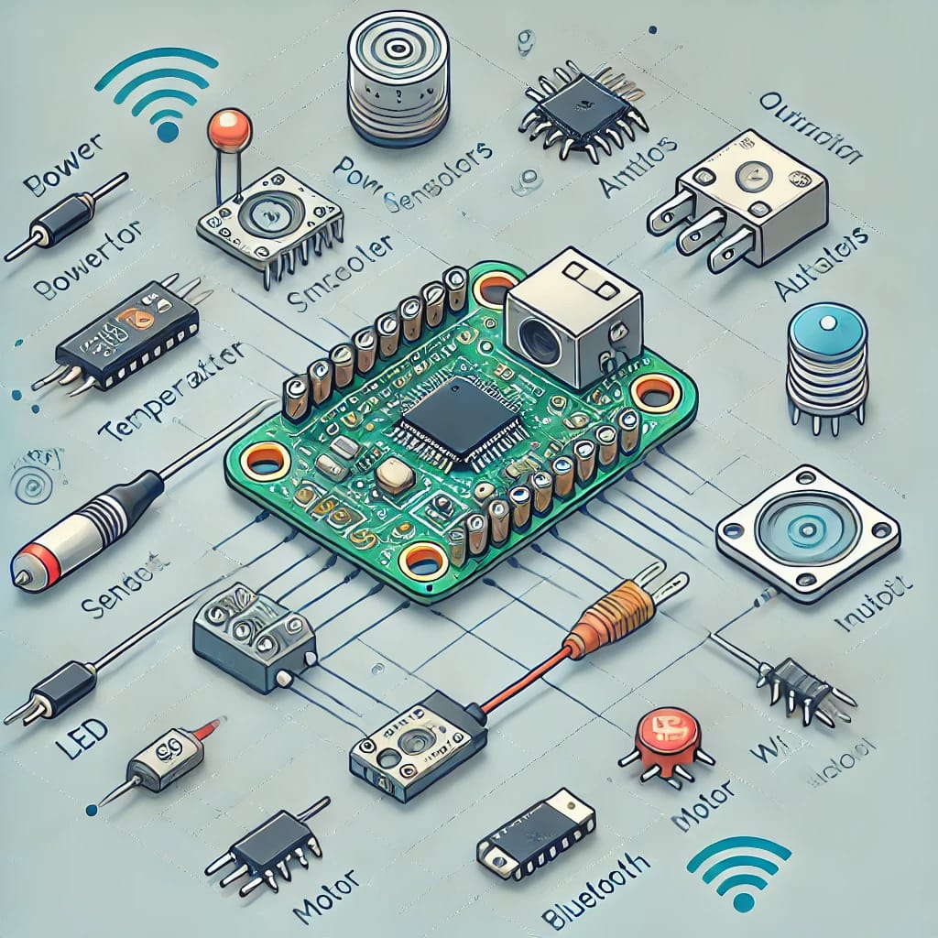
2- Installing and setting up STM32CubeIDE
3- Creating a new STM32 project
4- Introduction to HAL (Hardware Abstraction Layer) and LL (Low Level) drivers
These libraries help developers interact with hardware peripherals without dealing with low-level register configurations manually.
*Practical*
Running an built-in example in STM32cube

